Slide 1
Aladdin Technology Co., Ltd.
Company Overview
UPDATE – 2025/ 08
www.aladdin-techec.com

Slide 2
Contents
1. Company Overview
2. Services
3. President
4. Team
5. Case Studies
6. Our Strengths
7. Revenue & Consultant Growth

Slide 3
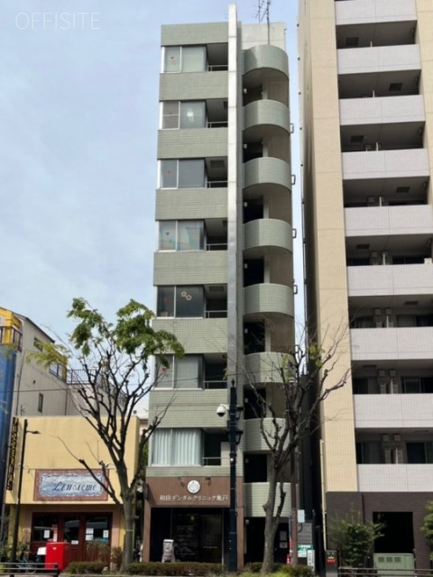
1. Company Overview
Company | Aladdin Technology Co., Ltd. (ADT)
President | President & CEO Liu Rui
Founded | March 2021
Capital | JPY 3 million
Employees | 50 (including partners)
Phone | (+81)03-5858-8802
Location | Center Bldg. 6F, 1-31-7 Kameido, Koto-ku, Tokyo 136-0071
Business | SAP Consulting System Development IT Services
 | Paid employment placement license: 13-Yu-316896 Worker dispatch license: Ha 13-317412 Tokyo Management Innovation Plan: Sanro-Shosho No. 1650

Slide 4

2. Services
SAP Implementation Consulting
End-to-end support for designing and implementing SAP solutions tailored to your needs.
Business requirement analysis and solution proposals
Project planning and execution
System design, build & testing
Production cutover support
User training & knowledge transfer
IT System Development
Custom development and SAP add-ons for your unique requirements.
Upgrades to the latest SAP versions and migration to the cloud.
Strategy and implementation for efficient migration from legacy SAP to S/4HANA.
Latest AI Technology
End-to-end consulting and support to bring world-leading AI to Japanese businesses.

Slide 5
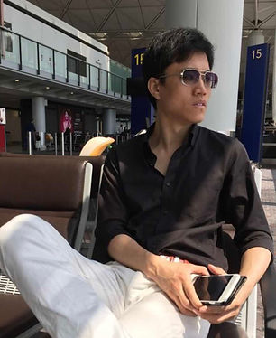
3. President
Career Overview
2021–Present | Aladdin Technology (founded) | Sales Manager / SAP Manager | Leads ~50 consultants 40+ SAP projects delivered
2014 | SUCCESS IT SAP implementation & support | SAP Lead Consultant / Global Sales Director (JP/EN) | - Led multinational teams & global projects
2012 | ABeam Consulting SAP implementation & support | SAP Consultant (MM/PP) | - Manufacturing: requirements to rollout
2010 | Idemitsu Kosan SAP implementation & support | SAP Engineer (ABAP/SD/MM/PP) | - Core system development & maintenance
2008 | Nomura Research Institute Internet banking project | Team Leader (15 members) | - Led core banking design & development
2007 | Toyota Motor ERP project | Engineer Java / C# / SQL / COBOL | - Production systems development
President: Liu Rui
SAP bilingual consultant
Sales manager
Project manager

Slide 6
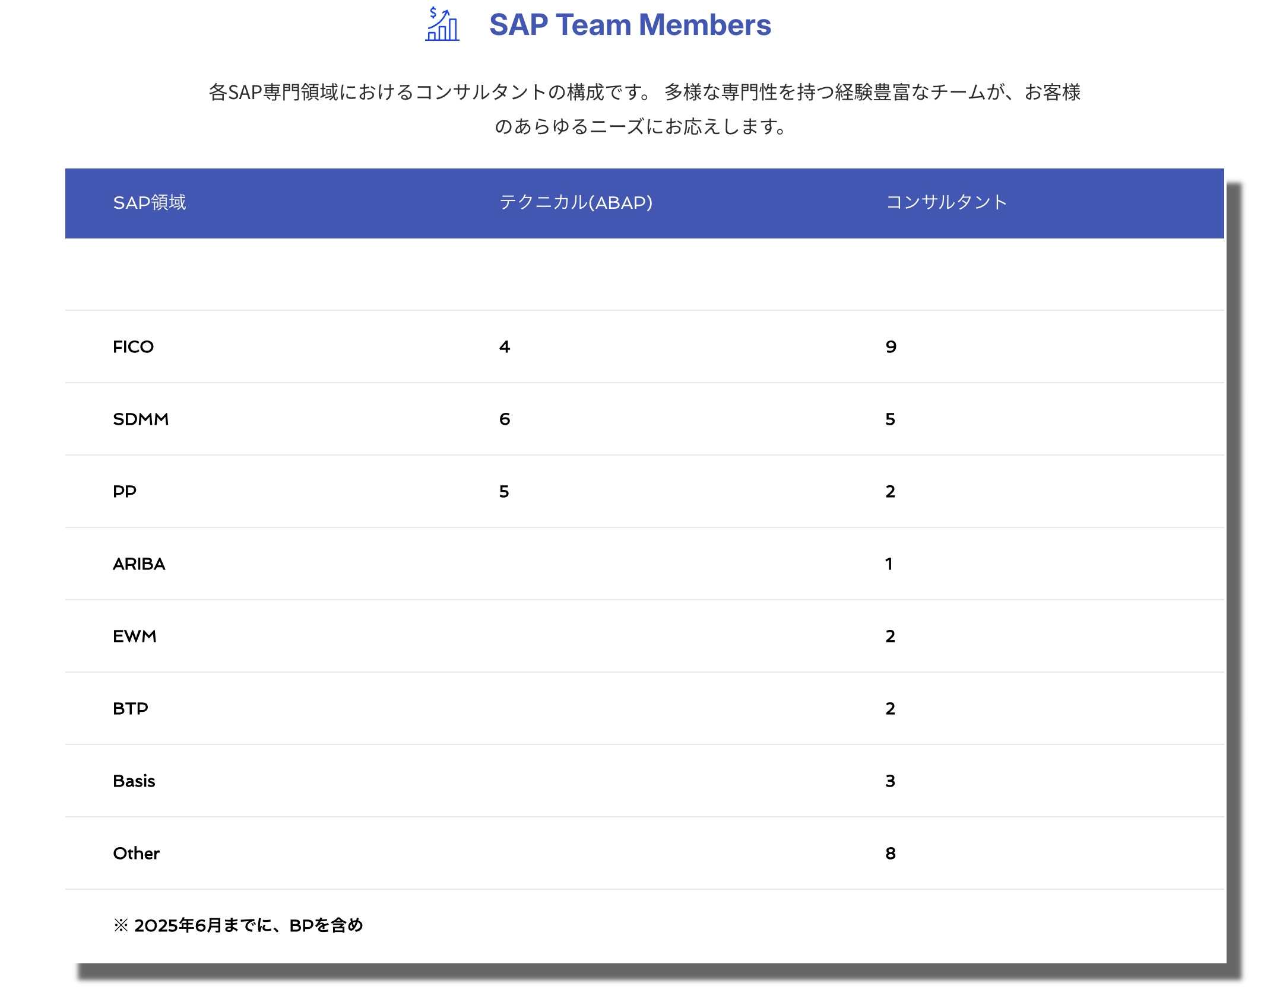
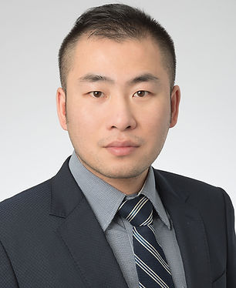
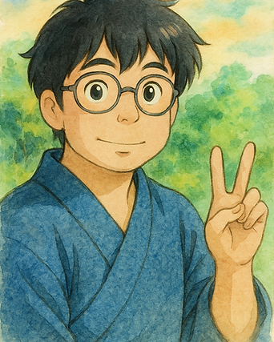
4. SAP Team
Management
Liu Rui — President & Sales Head
13 yrs bilingual SAP senior consultant
Hobbies: Travel, reading
Jin Yu — Vice President & CTO
15 yrs bilingual SAP senior consultant
BIG4 Senior Manager
Hobbies: Diving, skiing
Daniel Zhou — Head of SAP
10 yrs bilingual SAP senior consultant
Top consulting firm
Hobbies: Cooking, reading

Slide 7

5. Case Studies
See how Aladdin Technology helped clients solve business challenges and
achieve results through SAP implementation projects.
Industry / Client | Challenge | Solution | Impact
Manufacturing — Auto parts maker A | Legacy systems caused inefficiency & delays | SAP S/4HANA + supply chain optimization | Shorter production lead time Lower inventory cost Global standard processes
Retail — Major chain B | Omnichannel gaps and weak CX | SAP Customer Experience + ERP integration | Higher customer satisfaction Better inventory turnover Sales growth (personalization)
Financial — Major bank C | Complex, costly processes under stricter regulation | SAP S/4HANA Finance + process redesign | Faster financial close Lower compliance workload Better risk management
※ Since our founding, we have provided consulting for 40+ SAP projects (implementation, rollout, upgrade, and maintenance) — supporting clients end-to-end from requirements definition to post-go-live optimization across manufacturing, retail, financial, and public sectors.

Slide 8
6. Our Strengths
High-quality bilingual SAP consultants
Experienced SAP consultants from top firms, fluent in Japanese and English.
Strong leadership and a China–Japan SAP network
Liu has built a Japan-wide network of Chinese SAP consultants for fast response.
Fast, accurate resource assignment
We understand client needs and assign the right resources quickly.
Early risk detection and response
We identify and manage risks early to minimize disruptions.
A trusted long-term partner
We build sustainable partnerships on transparency and trust, delivering lasting results.

Slide 9
7. Revenue and Consultant Growth
2021–2025 Forecast

Slide 10
Contact Us
www.aladdin-techec.com
Thank you for listening

